Slide 1
Protein Pow(d)er
Programmeertheorie, Week 2, Presenteersessie 1
Team: Shire Peasants 3
Authors: Mark Dzoljic, Loek van Steijn, Sebastiaan Kruize

Slide 2
Format of the presentation
1. Introduction in the casus
State Space of the problem
2. Datastructures
Dictionairy vs. Matrix
3. Algorithms
Random, Greedy
4. Results & Runtimes
5. Q&A and discussion

Slide 3
1. Introduction: Stability of proteins
Proteins fulfill numerous function inside the human body
Faulty proteins linked to diseases such as Alzheimers or huntington

Slide 4
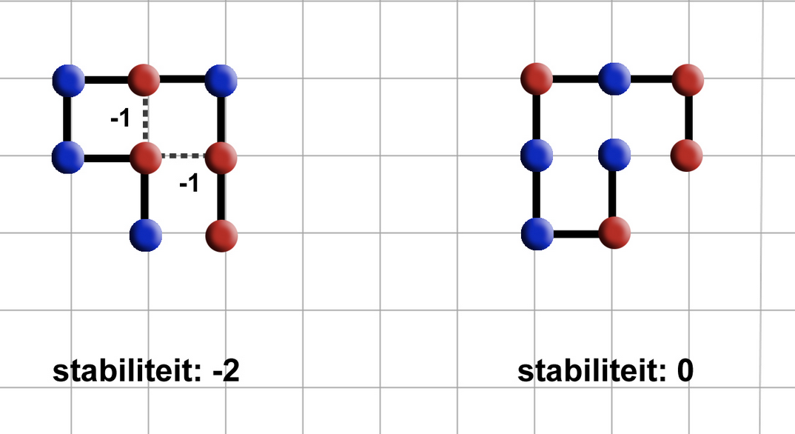
1. Introduction: Stability of proteins
As more hydrophobic amino-acids (red) are next to each other, the more stable it is
Stability of 0 means unstable
Stability of -2 means more stable.
Goal is to find protein structures that are as stable as possible.

Slide 5
1. Heuristics of Protein Pow(d)er
Constrained Optimization Problem
Constraints
Amino-acid string is given
All amino-acids must be used
Amino-acids cannot overlap
Optimization
Legitimate solution with the highest

Slide 6
1. State Space en upper/lower bounds
Statespace
→ 4^{n-1}
Amino acids cannot overlap
→ 4*3^{n}
→ 3^{n-2}
Upperbound: 3x
Met x is aantal H-elements
Lowerbound: > 0

Slide 7
2. Datastructures
Dictionaries
Use dictionaries to store elements with coordinates. Bind them with a direction variable
Matrixes
Use of a matrix object to store elements.

Slide 8
3. Algorithms
Suboptimal results:
Random
Greedy
Optimal results
Linear algorithm

Slide 9
4. Method: Possible algorithms
Name | Result | Method | Ω (Best Case) | Runtime (1000 iterations) Dict | Runtime (1000 iterations) Matrix
Random | Sub-optimal | Constructive
Greedy | Sub-optimal+ | Constructive
Lineair | Optimal | Constructive
Future | - | -

Slide 10
Questions and comments?
Our questions:
All our algorithms are ‘constructive’. Ideas where to think regarding iterative algorithms?
What is your view on our choice for datastructure?
Thank you for your attention

